Slide 1
Second Normal Form (2NF)

Slide 2
What is 2NF?
The second step in Normalization is 2NF.
A table is in 2NF, only if a relation is in 1NF and meet all the rules, and every non-key attribute is fully dependent on primary key.
The Second Normal Form eliminates partial dependencies on primary keys.
Let us see an example −

Slide 3
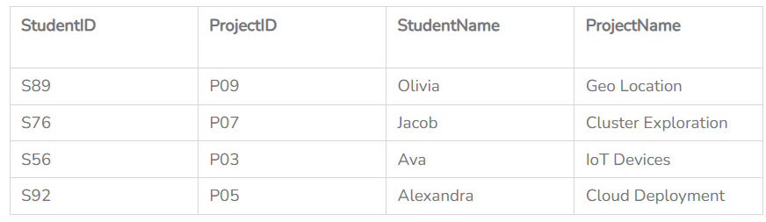
Example (Table violates 2NF)
<StudentProject>

Slide 4
In the above table, we have partial dependency; let us see how −
The prime key attributes are StudentID and ProjectID.
As stated, the non-prime attributes i.e. StudentName and ProjectName should be functionally dependent on part of a candidate key, to be Partial Dependent.
The StudentName can be determined by StudentID, which makes the relation Partial Dependent.
The ProjectName can be determined by ProjectID, which makes the relation Partial Dependent.
Therefore, the <StudentProject> relation violates the 2NF in Normalization and is considered a bad database design.

Slide 5

Example (Table converted to 2NF)
To remove Partial Dependency and violation on 2NF, decompose the above tables −
Now the relation is in 2nd Normal form of Database Normalization

Slide 6
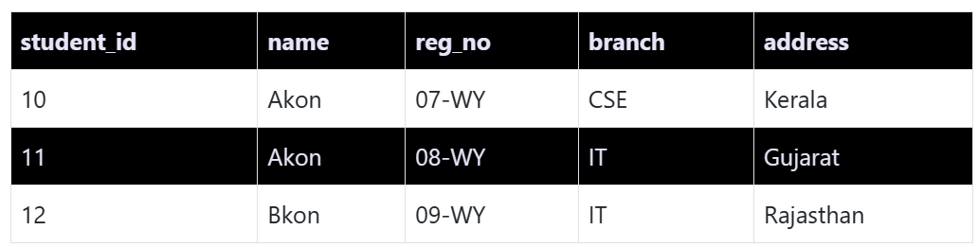
Third Normal Form (3NF)
Third Normal Form is an upgrade to Second Normal Form.
When a table is in the Second Normal Form and has no transitive dependency, then it is in the Third Normal Form.
So let's use the same example, where we have 3 tables, Student, Subject and Score.
Student Table

Slide 7
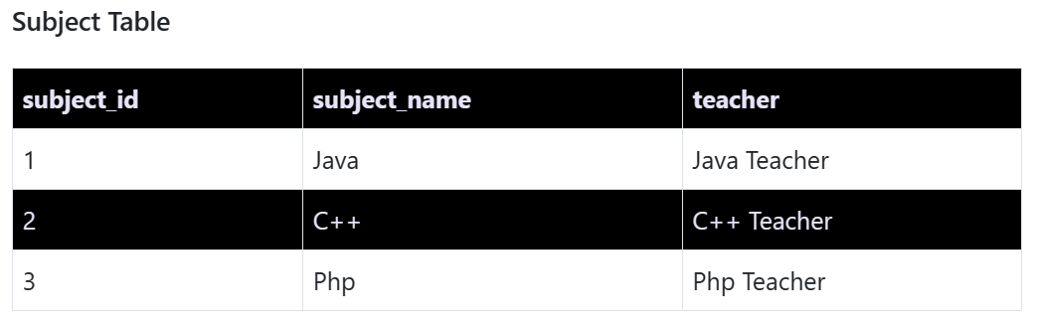
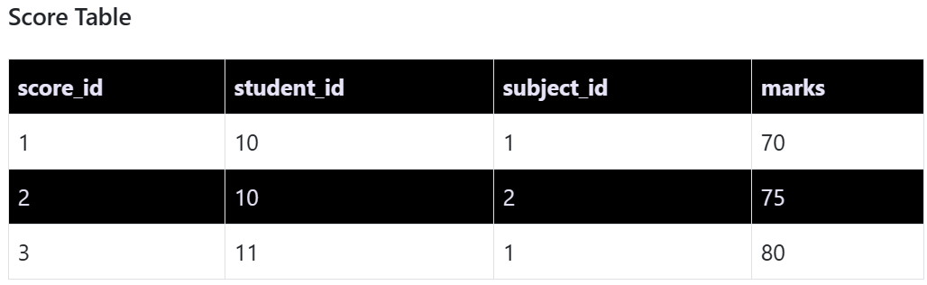

Slide 8

In the Score table, we need to store some more information, which is the exam name and total marks, so let's add 2 more columns to the Score table.
Requirements for Third Normal Form
For a table to be in the third normal form,
It should be in the Second Normal form.
And it should not have Transitive Dependency.

Slide 9
What is Transitive Dependency?
With exam_name and total_marks added to our Score table, it saves more data now.
Primary key for our Score table is a composite key, which means it's made up of two attributes or columns → student_id + subject_id.
Our new column exam_name depends on both student and subject.
For example, a mechanical engineering student will have Workshop exam but a computer science student won’t.
And for some subjects you have Prctical exams and for some you don’t.
So we can say that exam_name is dependent on both student_id and subject_id.

Slide 10
And what about our second new column total_marks? Does it depend on our Score table's primary key?
Well, the column total_marks depends on exam_name as with exam type the total score changes.
For example, practicals are of less marks while theory exams are of more marks.
But, exam_name is just another column in the score table.
It is not a primary key or even a part of the primary key, and total_marks depends on it.
This is Transitive Dependency. When a non-prime attribute depends on other non-prime attributes rather than depending upon the prime attributes or primary key.

Slide 11
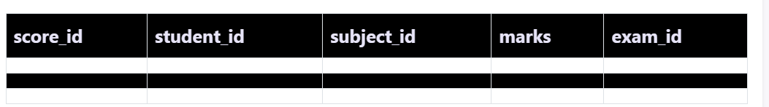
How to remove Transitive Dependency?
Again the solution is very simple. Take out the columns exam_name and total_marks from
Score table and put them in an Exam table and use the exam_id wherever required.
Score Table: In 3rd Normal Form

Slide 12
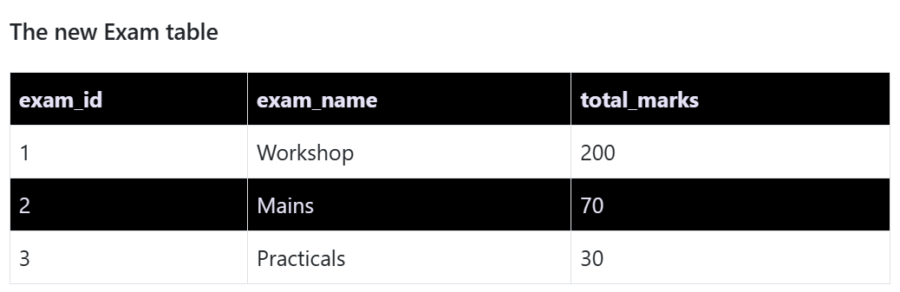
Advantage of removing Transitive Dependency
The advantage of removing transitive dependency is,
Amount of data duplication is reduced.
Data integrity achieved.

Slide 13
Boyce-Codd Normal Form (BCNF)
Boyce-Codd Normal Form or BCNF is an extension to the third normal form, and is also known as 3.5 Normal Form.
Rules for BCNF
For a table to satisfy the Boyce-Codd Normal Form, it should satisfy the following two conditions:
It should be in the Third Normal Form.
And, for any dependency A → B, A should be a super key.
The second point sounds a bit tricky, right? In simple words, it means, that for a dependency A → B, A cannot be a non-prime attribute, if B is a prime attribute.

Slide 14
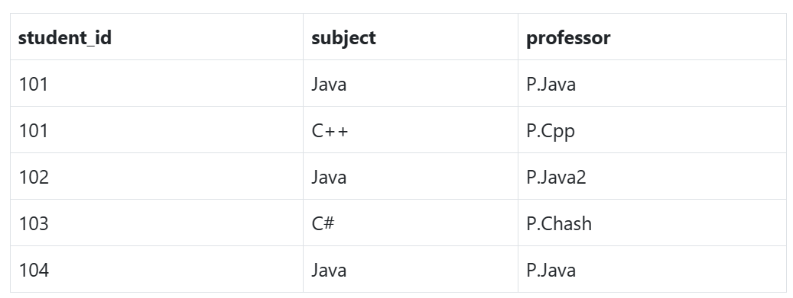
Below we have a college enrolment table with columns student_id, subject and professor.
As you can see, we have also added some sample data to the table.

Slide 15
In the table above:
One student can enrol for multiple subjects. For example, student with student_id 101, has opted for subjects - Java & C++
For each subject, a professor is assigned to the student.
And, there can be multiple professors teaching one subject like we have for Java.

Slide 16
What do you think should be the Primary Key?
Well, in the table above student_id, subject together form the primary key, because using student_id and subject, we can find all the columns of the table.
One more important point to note here is, one professor teaches only one subject, but one subject may have two different professors.
Hence, there is a dependency between subject and professor here, where subject depends on the professor name.
This table satisfies the 1st Normal form because all the values are atomic, column names are unique and all the values stored in a particular column are of same domain.

Slide 17
This table also satisfies the 2nd Normal Form as their is no Partial Dependency.
And, there is no Transitive Dependency, hence the table also satisfies the 3rd Normal Form.
But this table is not in Boyce-Codd Normal Form.

Slide 18
Why this table is not in BCNF?
In the table above, student_id, subject form primary key, which means subject column is a prime attribute.
But, there is one more dependency, professor → subject.
And while subject is a prime attribute, professor is a non-prime attribute, which is not allowed by BCNF.

Slide 19
How to satisfy BCNF?
To make this relation(table) satisfy BCNF, we will decompose this table into two tables, student table and professor table.
Below we have the structure for both the tables.

Slide 20
